Slide 1

Design and Analysis of Algorithms
Dinesh Singh
Department of Computer Science & Engineering

Slide 2

DESIGN AND ANALYSIS OF ALGORITHMS
Space and Time Trade-offs
Dinesh Singh
Department of Computer Science & Engineering

Slide 3
Design and Analysis of Algorithms
Space and Time Trade-offs
Concept of trading memory (space) for faster computation (time) in algorithms
Input Enhancement
  Preprocess the problem’s input, in whole or in part, and store the additional information obtained to accelerate solving the problem afterwards.
  Eg: Counting methods of sorting, Horspool’s algorithm, Boyer-Moore’s algorithm.
Pre-structuring
  Use of extra space to facilitate faster and/or more flexible access to the data.
  Eg: Hashing, Indexing with B-Trees
Dynamic Programming
  This strategy is based on recording solutions to overlapping sub problems of a given problem in a table from which a solution to the problem in question is then obtained.

Slide 4
Design and Analysis of Algorithms
Space and Time Trade-offs
Comparison Counting Sorting
  For each element of the list, count the total number of elements smaller than the element and record the results in a table.
  These numbers indicates the positions of the elements in the sorted list.
Example 62 31 84 96 19 47
# lesser elements: 3 1 4 5 0 2
  Sort the array by copying its elements to their appropriate positions in a new, sorted list
19 31 47 62 84 96
0 1 2 3 4 5

Slide 5
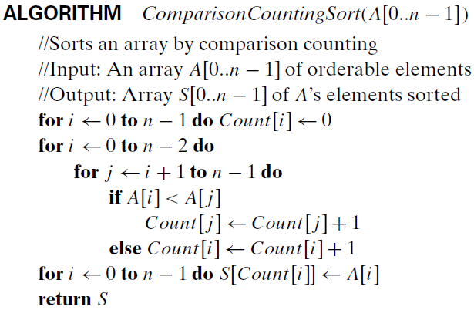
Design and Analysis of Algorithms
Space and Time Trade-offs

Slide 6
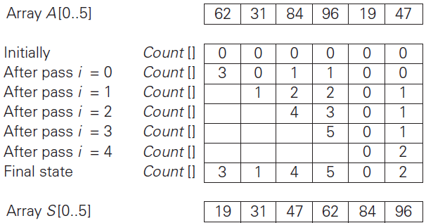
Design and Analysis of Algorithms
Space and Time Trade-offs

Slide 7


Design and Analysis of Algorithms
Space and Time Trade-offs
What is the time efficiency of this algorithm?
The algorithm makes the same number of key comparisons as selection sort and in addition uses a linear amount of extra space.
On the positive side, the algorithm makes the minimum number of key moves possible, placing each of them directly in their final position in a sorted array

Slide 8
Design and Analysis of Algorithms
Space and Time Trade-offs
Distribution Counting Sorting
  Suppose the elements of the list to be sorted belong to a finite set .
  Count the frequency of each element of the set in the list to be sorted.
  Scan the set in order of sorting and print each element of the set according to its frequency, which will be the required sorted list.

Slide 9
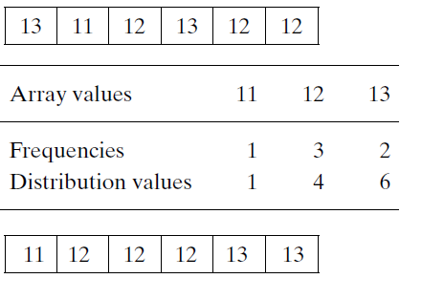
Design and Analysis of Algorithms
Space and Time Trade-offs
Distribution Counting Sorting :Consider sorting the array[13,11,12,13,12,12] , whose values come from the set. { 11, 12, 13 }. The distribution values indicate the correct positions for the last occurrences of elements in the final sorted array.The frequency and distribution values are as follows:

Slide 10
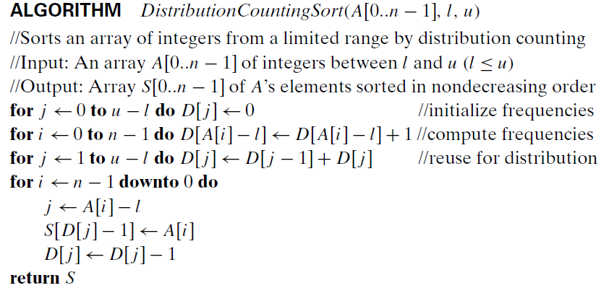
Design and Analysis of Algorithms
Space and Time Trade off
Distribution Counting Sorting

Slide 11
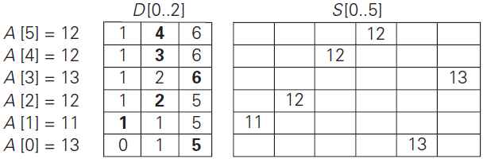
Design and Analysis of Algorithms
Space and Time Trade off
Distribution Counting Sorting

Slide 12
Design and Analysis of Algorithms
Space and Time Trade off
Distribution Counting Sorting
Assuming that the range of array values is fixed, this is a linear algorithm because it makes just two consecutive passes through its input array.
This is a better time-efficiency class than that of the most efficient sorting
algorithms—mergesort, quicksort, and heapsort

Slide 13
Design and Analysis of Algorithms
Multiple choice Questions
In comparison counting sort, the value stored in Count[i] represents
The number of elements greater than A[i]
The number of elements smaller than A[i]
The number of times A[i] appears in the array
The number of comparisons involving A[i]
Answer: B The number of elements smaller than A[i]

Slide 14
Design and Analysis of Algorithms
Multiple choice Questions
The number of key comparisons performed by the ComparisonCountingSort algorithm for an array of size n is:
n log⁡n
n(n−1) / 2​
n²
n(n+1) / 2
Answer : B n(n−1) / 2​

Slide 15
Design and Analysis of Algorithms
Multiple choice Questions
Compared with selection sort, comparison counting sort:
A. Uses fewer comparisons and less space
B. Uses the same number of comparisons but additional space
C. Uses fewer comparisons but more swaps
D. Uses more comparisons but fewer swaps
Answer : B. Uses the same number of comparisons but additional space

Slide 16
Design and Analysis of Algorithms
Multiple choice Questions
In distribution counting sort, suppose the input values range from l to u.
The size of the frequency array D must be:
n
u
u−l+1
n(u−l)
Answer : C . u−l+1

Slide 17
Design and Analysis of Algorithms
Multiple choice Questions
Consider the algorithm DistributionCountingSort(A[0..n−1], l, u).
Which of the following statements correctly explains why the algorithm processes the input array from right to left when constructing the sorted array S?
A. To reduce the number of comparisons in the algorithm
B. To ensure that the algorithm remains stable
C. To reduce the extra space required by the distribution array
D. To ensure that the distribution array can be reused
Answer : B. To ensure that the algorithm remains stable

Slide 18
THANK YOU
Dinesh Singh
Department of Computer Science & Engineering

